Slide 1
Activity #2
Group 2

Slide 2

Topic
Perform a decryption and encryption process. You may use any alternative sites that can perform such, or even have your own system where it can be seen and performed. Explain its importance and its relevance to information security.

Slide 3

What is encryption?

Slide 4
Encryption
is the process by which a readable message is converted to an unreadable form to prevent unauthorized parties from reading it.

Slide 5
What is decryption?

Slide 6
Decryption
is the process of converting an encrypted message back to its original (readable) format.

Slide 7
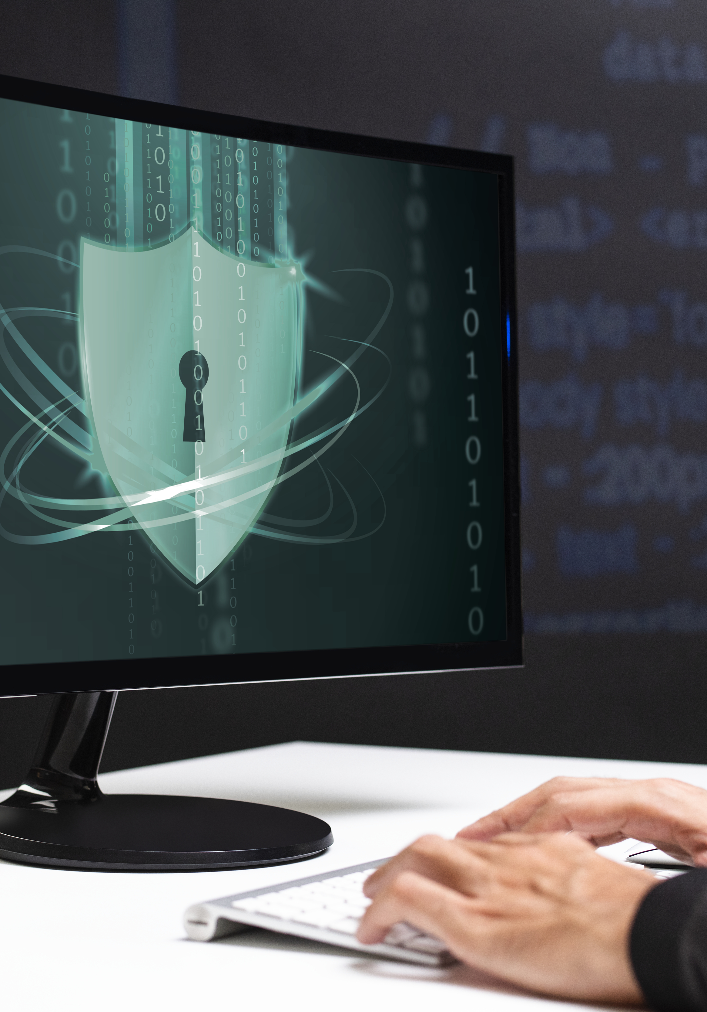


2 types of key encryption

Slide 8
Shared Key Encryption

Slide 9
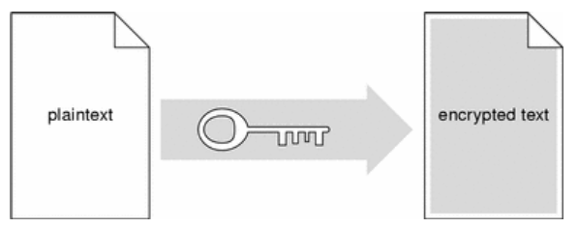
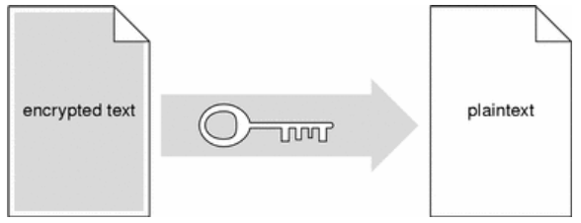
What is shared key encryption?
uses one key to encrypt and decrypt messages.
Sender Uses Key to Encrypt Plaintext to Ciphertext
Recipient Uses Key to Decrypt Ciphertext to Plaintext

Slide 10
Public Key Encryption

Slide 11

What is public key encryption?
uses a pair of complementary keys (a public key and a private key) to encrypt and decrypt messages
Public key & Private key

Slide 12
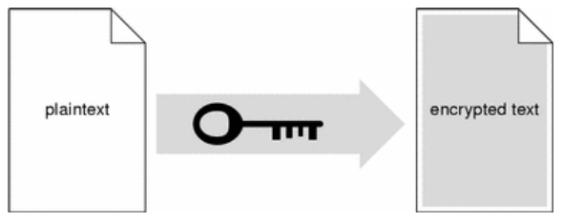
In public key encryption systems, users make their public key available to anyone and keep their private key secret.
When one user wants to send a private message to another user, the sender looks up the recipient's public key and uses it to encrypt a message.
Sender Uses Recipient's Public Key to Encrypt Message

Slide 13
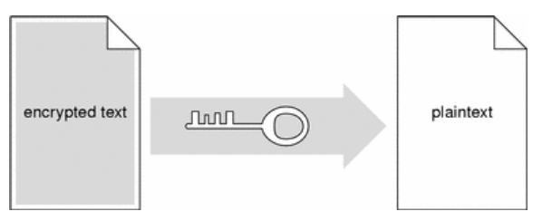
When the encrypted message arrives, the recipient uses his or her private key to decrypt the message.
Recipient Uses Private Key to Decrypt Message
Reference: https://docs.oracle.com/cd/E19047-01/sunscreen151/806-5397/i996724/index.html

Slide 14
Performing decryption and encryption process.

Slide 15
Importance and its relevance to information security

Slide 16
Encryption and decryption come together when used as tools to protect the user’s information or data from unauthorized access. Even if the data is leaked, encryption ensures it remains unreadable without the correct decryption key. This helps the data remain secure by providing an extra layer of defense.

Slide 17
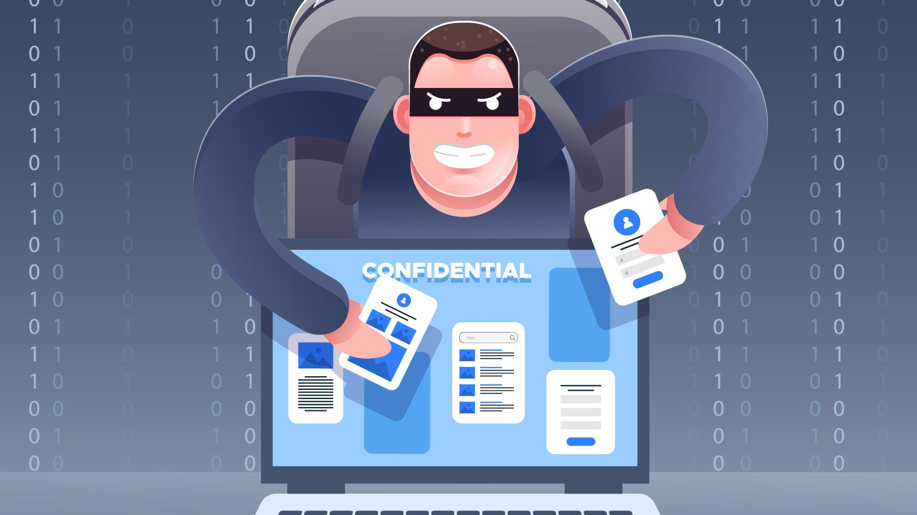
Thank you
Presentors:
Arriesgado, Jemay
Casas, Noli Jr.
Mapula, Abiegail
Mongaya, Reliza
Montesclaros, Reynaliza
Pepito, Christina
Secuya,Jessah
17

